Slide 1
While you watch the video on the next slide, jot down answers to the following questions in your BILL
What initiates the entire sequence of events that you see? What if it had started with a different initiator?
Think about how everything you see unfolds. What patterns do you notice in what you see?
Think about the end: what would happen if the last step happened repeatedly?

Slide 2
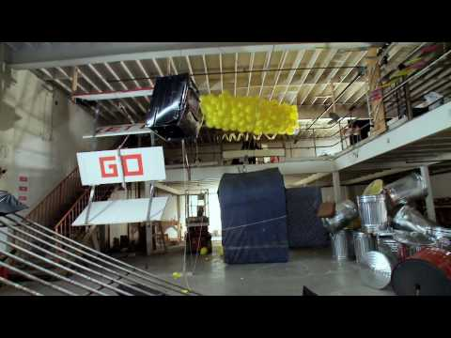
What initiates the entire sequence of events that you see? What if it had started with a different initiator?
Think about how everything you saw unfolded. What patterns do you notice in what you see?
Think about the end: what would happen if the last step happened repeatedly?

